Slide 1
HCV Utilization Webinar
April 18, 2024
Notes:
Please ask your questions in the chat.

Slide 2
Today’s Agenda
Updates on 2024 Funding
Source of Income Protections Website
  Seattle Housing Authority
  Boise City/Ada County Housing Authority
FYI Competitive Funding Notice
2024 FYI/FUPY Convenings
VASH Admin Fee Notice

Slide 3
Welcome!
Today's webinar is being recorded. The recording and PowerPoint will be posted to the "Webinars and Trainings” section of www.hud.gov/hcv. In about a week.
We are always interested in your feedback. Please enter any suggestions you have for how we can make these webinars or the program resources more useful to you in the chat.
Stay connected by visiting www.hud.gov/hcv and subscribing to the HCV Connect Newsletter.

Slide 4

Program Updates: New Funding
2024 Funding Timeline:
  Congress Passed 2024 Consolidated Appropriation Act (March 8, 2024)
  PHA HAP Renewal Funding Announcements (expected by May 8th)
  HCV Implementation Notice in Clearance (expected by May 8th)
  CYE 2023 HAP Reconciliation enclosures going out the week of 4/15/2024
What should PHAs do in the meantime:
Please continue to use the Two-Year Tool to make informed program decisions
Contact your Financial Analyst at the FMC if you need additional funds

Slide 5
Highlights of the 2024 Appropriations
  Contract Renewals ($28.5B) increased by $2.1B from 2023.
  $2.8B for Admin Fees - ~93% proration
  $200M in HAP set aside.
  Offset from program reserves for reallocation is likely (proration and shortfalls).
  $15M in HUD VASH and $30M FUP New Incremental Vouchers
  New: carryover and recaptures can be used to increase the Administrative Fee proration.

Slide 6

Source of Income Discrimination: What is it?
Applicants must qualify for the unit without before section 8 subsidy.
The HCV Program allows participants to use their voucher to find affordable housing in the rental market.
The goal of this program is to provide participants with choice, and access to areas of opportunity.
Discrimination against voucher holders, adds barriers to and limits participants from being successful in using their vouchers.
Sect. 8 Applicants need:
Extra security deposit
Extra references

Slide 7

Source of Income Protections
SOI antidiscrimination laws make it illegal to refuse to rent to, or otherwise disadvantage, tenants who pay rent with housing vouchers and other types of housing assistance.
More than half of voucher holders live in a jurisdiction with a SOI antidiscrimination laws

Slide 8
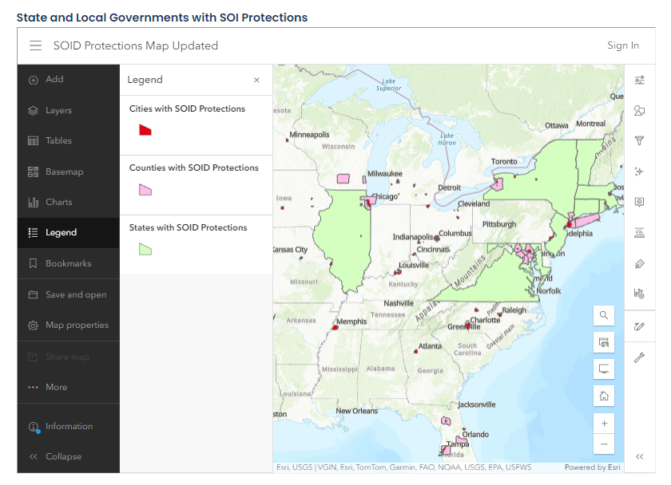
New Webpage on SOI Protections
An interactive map to help identify the city, county and state jurisdictions with laws prohibiting source of income discrimination.
Tips for voucher holders facing discrimination from landlords refusing to accept vouchers for payment.
Reminder that Low Income Housing Tax Credit Properties are required to accept vouchers as a source of payment.
Information for stakeholders interested in establishing their own anti-discrimination laws.
Check it out: https://www.hud.gov/Program_Offices/Public_Indian_Housing/Source_Income_Protections

Slide 9

Local Advocacy for SOIP: Deep Dive with a PHA
Deanna Watson, Executive Director

Slide 10

Local Advocacy for SOIP: Deep Dive with a PHA
Alice Kimbowa,
Director of Rental Assistance Programs

Slide 11
FYI Competitive NOFO
HUD announced $12.7M in Foster Youth to Independence (FYI) Competitive under a Notice of Funding Opportunity (NOFO) published on April 17, 2024.
The full NOFO can be found here (link below) and on Grants.gov.
The NOFO training video will be available on the FYI Webpage.
Deadline to apply: June 17, 2024.
Questions: FYICompetitive@hud.gov
https://www.hud.gov/program_offices/cfo/gmomgmt/grantsinfo/fundingopps
Notes:
Maren

Slide 12
FYI/FUP-Y Convenings
Enhancing Collaboration & Centering Youth Voices for Housing Solutions
Three Objectives
Attendees
PHAs with FYI & FUP
Public Child Welfare Agencies
CoCs & Other local partners
Youth with Lived Experience
Improve FYI and FUP-Y leasing.
Enhance local collaboration and strengthen community partnerships.
Center equity and youth with lived experience.
Notes:
Maren

Slide 13
FYI/FUP-Y Convenings
Region | Location | Dates
VIII | Denver, CO* | May 16-17
III | Philadelphia | June 11 - 12
I & II | Boston, MA | July 24-25
VII | Kansas City, MO | July 30-31
X | Seattle, WA | August 15-16
V | Chicago, IL | August 27-28
IV | Miami, FL | Sept 17-18
VI | TBD: San Antonio, TX | TBD
IX | TBD: Los Angeles, CA | TBD
*Only Region 8 Invitations have been sent.
Questions: FYIConvenings@hud.gov
Notes:
Maren

Slide 14
HUD-VASH Admin Fee Notice
Under Notice PIH 2024-10, $20 million was made available for eligible HUD-VASH Administrative fees.
Funding is available for uses such as landlord recruitment, housing search assistance activities, owner incentives, and other HUD-VASH expenses.
All applications should be submitted via the electronic submission form on the HUD-VASH webpage and the deadline to apply is May 31, 2024.
Please send questions and comments to VASH@hud.gov.
Notes:
Molly

Slide 15

Is your PHA using HCV Administrative Fees to help with Lease-up Expenses?
  Then, we want you hear from YOU!
  HUD’s Office of Policy Development & Research (PD&R) wants to learn more about how PHAs have been using HCV administrative fees to assist families with eligible lease-up expenses, such as security deposits, owner incentive payments, utility deposits/arrears, and application and holding fees. What is working well? What are some challenges?
  If your PHA uses or has used HCV administrative fees for tenant leasing expenses, please email Admin_Fee_Project@hud.gov, and let us know.
We will highlight best practices in a future HCV Utilization Webinar.
Notes:
Going to help PD&R – Future Policies – Share Best Practices
Help a lot of folks
No Deadline

Slide 16

Reminders
HUD has been working to improve the HCV utilization resources available to PHAs, in case you missed it here are two new items:
  HCV Connect – A email monthly newsletter focused on the HCV program with reminders of program guidance, notification of webinars, events, and research. ANYONE can sign up for HCV Connect at www.hud.gov/hcv.
  HCV Utilization Webinars – These webinars will provide HCV program updates and share best practices. They are scheduled for every third Thursday at 2:00 Eastern.
Register for future webinars and/or find recordings of prior webinars in the “Webinars and Trainings” section of www.hud.gov/hcv

Slide 17

Next Month’s Webinar
The next HCV Utilization Webinar is Thursday, May 16. This call will focus on implementation of the 2024 Funding and the Two-Year Tool.
If you have feedback on these webinars, or topic suggestions, please email HCVUtilization@hud.gov.

