Slide 1
HCV Utilization Webinar
January 18, 2024

Slide 2
Welcome!
Today's webinar is being recorded. The recording and PowerPoint will be posted to the "Webinars and Trainings” section of www.hud.gov/hcv. In about a week.
We are always interested in your feedback. Please enter any suggestions you have for how we can make these webinars or the program resources more useful to you in the chat.
Stay connected by visiting www.hud.gov/hcv and subscribing to the HCV Connect Newsletter.

Slide 3
Agenda
2023 Reconciliation and End of Year Reporting
2024 Funding
PIC Data Cleanup
Special Purpose Voucher Updates
Q&A

Slide 4
2023 Reporting Reminder
Review the letter that FMD sent at the end of December.
The deadline for submitting all 2023 VMS data and revisions by January 29, 2024.
PHAs are also required to submit household (50058) data within 60 days of the effective data. PIH will utilize 50058 data for funding adjustments and requires any 2023 data successfully submitted in PIC by 4pm, March 29, 2024.

Slide 5

Today's Presenters
  Jeff Zimmermann
  Program Analyst
  OHVP Program Support Division
  US Department of Housing & Urban Development
  Jeff.Zimmermann@hud.gov
  Maren Truchman
  Division Director
  OHVP Management And Operations Division
  US Department of Housing & Urban Development
  Maren.B.Trochmann@hud.gov
  Chad Ruppel
  Director
  OHVP Program Support Division
  US Department of Housing & Urban Development
  Eric.J.Swenson@hud.gov
  Courtney Herring
  Housing Program Specialist
  OHVP Management And Operations Division
  US Department of Housing & Urban Development
  Courtney.J.Herring@hud.gov

Slide 6
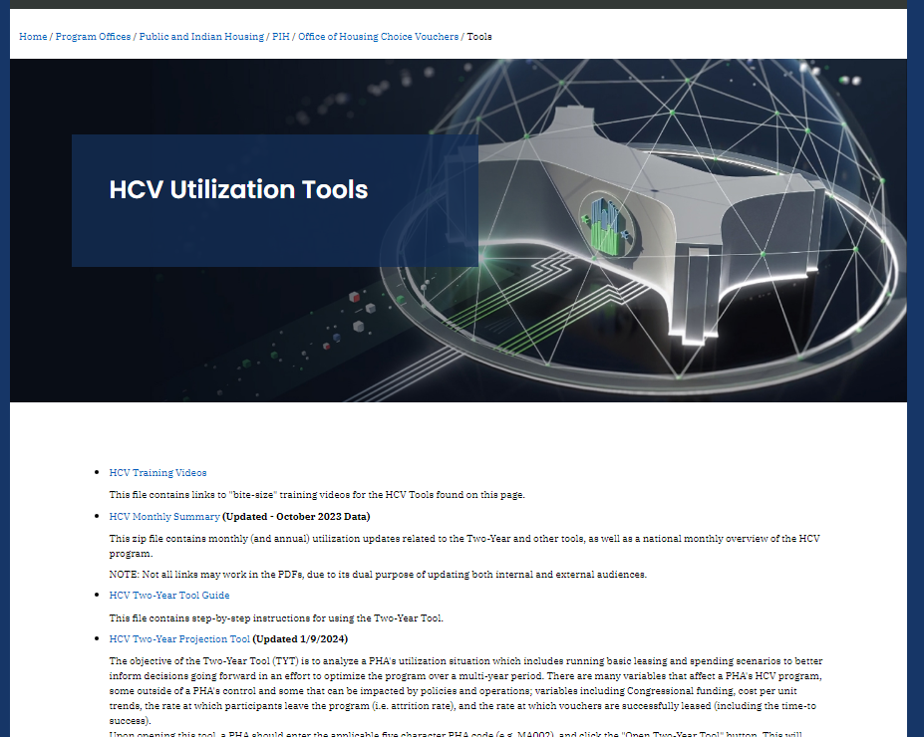
2024 Funding
HUD recently updated the Two-Year Tool (TYT) projections for 2024 according to the latest information we have. In many cases, PHAs may notice a lower projected funding amount for 2024. Since final funding amounts are still uncertain, we encourage PHAs to use these conservative estimates for program utilization in an effort to avoid any potential program shortfalls.
Here is where you can find the Two-Year Tool in the Utilization Tools section of www.hud.gov/hcv.

Slide 7

eVMS Update
eVMS has Completed Wave 1 On-Boarding
  These PHAs received their first HAP disbursements using eVMS calculations in January 2024.
  The HUD eVMS Website has been updated to include the Wave 1 On-Boarding Webinar. The presentation provides an overview of eVMS, goals and expectations, and how to prepare for migration.
  Wave 2 On-Boarding is currently being planned. The eVMS Team will share more details soon.
    The goal is to have all PHAs utilizing eVMS in CY2024.
  For questions, comments, suggestions, please contact us via AskEVMS@hud.gov
  For updated information and resources, please visit the eVMS Website

Slide 8
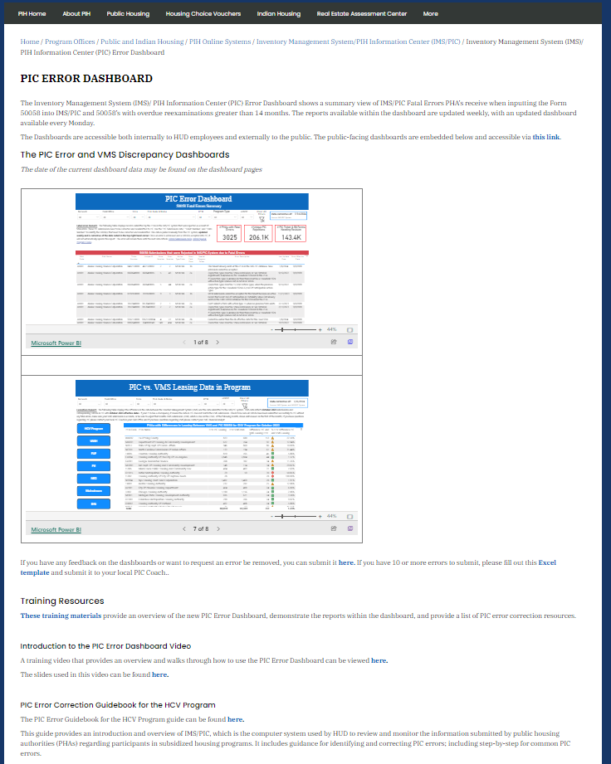
Reminder: the PIC Error Dashboards are available to help you improve reporting and to Prepare for EVMS
The PIC Error Dashboards are available at: https://www.hud.gov/program_offices/public_indian_housing/systems/pic/dashboard
Here you can find:
A dashboard that highlights PIC rejections
A dashboard that highlights differences between the a PHA's reporting in VMS vs PIC
Tip sheets and training videos to help PHAs correct reporting errors
HUD has on-call Technical Assistance available for HCV Program Administers who want a hand correcting reporting

Slide 9
EHV Updates
Upcoming Revoke: HUD is conducting a EHV revocation/reallocation in February 2024. There are 38 PHAs at-risk of revocation identified in PIH Notice 2023-31. These PHAs can avoid revocation by issuing all remaining EHVs by Feb 15th.
Reissuance Prohibition: PHAs are prohibited from reissuing EHVs upon turnover after Sept 30, 2023. To see how many EHVs you have left to issue, please check the EHV Data Dashboard
  Reminder: PHAs can consider success rates when issuing their remaining EHVs so it is okay to issue more EHVs than you have authority for see PIH Notice 2023-14. This prohibition does not apply to movers/ports
For additional resources, visit the EHV website.

Slide 10

Special Purpose Voucher (SPV) Updates
Notes:
Hand over to Maren/Courtney

Slide 11
HUD-VASH Updates
Boot Camp Recap
  HUD and VA jointly hosted a total of 10 HUD-VASH Boot Camp sessions around the country between August and December 2023
  More than 1,000 attendees participated in these sessions with over 200 HUD-VASH PHAs represented
Virtual Boot Camp Plans
  HUD and VA will work with TA providers to host a virtual version of the HUD-VASH Boot Camp in early 2024
New Awards
  Summer HUD-VASH ROI Awards will be made/Announced later this month
  $10M available for HUD-VASH Special Fees will be posted soon
Special note: Molly Allen was recently designated the HUD VASH National Coordinator.
Notes:
Courtney

Slide 12
Stability Vouchers & Mainstream Updates
Stability Vouchers
  FAQs have been posted on the Stability Voucher webpage
  Multiple TA products planned:
    Webinars
    Roadmap
    Referral tool
Mainstream
  Session of Communities of Practice just wrapped
  More CoP rounds in Spring 2024
Notes:
Courtney

Slide 13
FUP and FYI Updates
FUP
  13 PHAs received 625 vouchers for $10M under the FY22 NOFO
  Read more HUD's Press Release No. 23-281 from December 19, 2023
FYI
  FY2024 NOFO ($12.7M) planned for Spring 2024 publication
  FYI Noncompetitive funding still available under PIH Notice 2023-04
Notes:
Maren

Slide 14
Youth & Young Adult Housing Convenings
What?
  9-10 in-person regional convenings planned (April-October)
Who?
  FYI PHAs & local YHDP/CoC Grantees, PCWAs partners
  Youth with Lived Experience
Why?
  Improve FYI utilization (process improvement mapping)
  Enhance local collaboration and partnerships
  Center equity & young adults with lived experience
Notes:
Maren

Slide 15
Other SPV Updates
Quarterly Special Purpose Voucher (SPV) Office Hours planned for PHAs moving forward
  2024 dates: April, July, October
  Opportunity for more in-depth Q&A, Best Practices sharing, and peer interaction
Major policy updates and new funding opportunities will still be shared during HCV Utilization calls
Notes:
Maren

Slide 16

Reminders
HUD has been working to improve the HCV utilization resources available to PHAs, in case you missed it here are a few new items:
  HCV Connect – A email newsletter focused on the HCV program with reminders of program guidance, notification of webinars, events, and research.
  HCV Utilization Webinars – These webinars will provide HCV program updates and share best practices. They are scheduled for every third Thursday at 2:00 Eastern.
  HCV Overview Video Series with short videos covering common topics in HCV program administration.
  Plus, we have ongoing support for the HCV Utilization Tools and the HCV Data Dashboard.
All of this is available at:
www.hud.gov/hcv

Slide 17
Topics for Next Month's HCV Utilization Webinar
More 2024 funding updates
Review of Landlord Engagement Resources
Updates to the reconciliation template
To register for this webinar please visit the Webinars and Trainings section of www.hud.gov/hcv.

